Slide 1
Considerations for the 2020 duck season
Current as at 6 December 2019

Slide 2
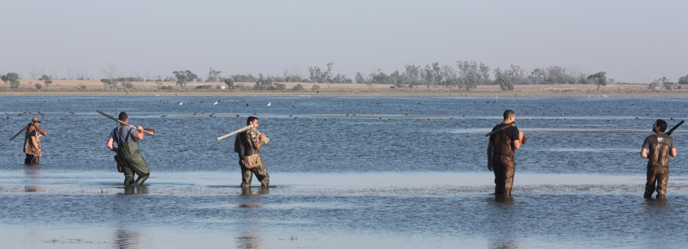
Duck hunting in Victoria
There are approx. 25,000 hunters licensed to hunt duck in Victoria.
Duck hunting is regulated to ensure it remains safe, sustainable, humane and equitable.
The Victorian duck season is prescribed under the Wildlife (Game) Regulations 2012 to occur every year between the third Saturday in March and the second Monday in June. Daily bag limits and hunting methods are also prescribed.
A number of factors are reviewed each year to ensure duck hunting remains sustainable, including current and predicted environmental conditions, game duck abundance, distribution and productivity and habitat extent and distribution.
The Minister for Agriculture and Minister for Environment may modify (increase/decrease bag limits and season dates, further regulate time, place and methods) the prescribed arrangements under section 86 of the Wildlife Act 1975.

Slide 3
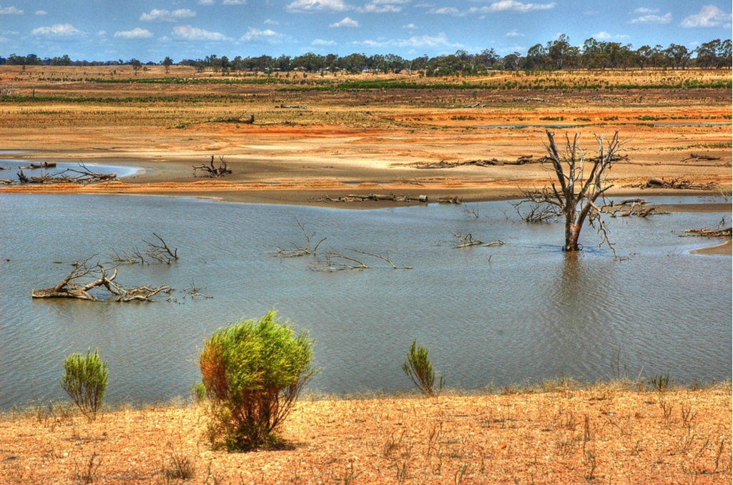
Climate
Past and present climatic conditions dictate present environmental conditions
Climatic predictions can be used to consider whether environmental conditions will change into the future

Slide 4
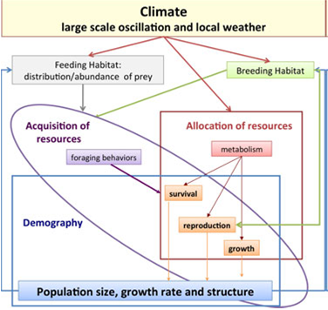
Climatic conditions and waterfowl
Climatic conditions, such as large scale oscillations (e.g. Southern Oscillation Index) and local weather (e.g. rainfall and temperature), can effect the distribution, productivity and size of waterfowl populations.
In Australia, waterbird abundance is strongly related to river flows and rainfall.
Large and extensive rainfall events can contribute to population increase as the conditions are enhanced to support breeding and recruitment. Conversely, during dry periods, breeding may be modified or greatly reduced (see Kingsford and Norman 2002).
Climate effect on waterbird populations. Source: Jenouvrier 2013

Slide 5
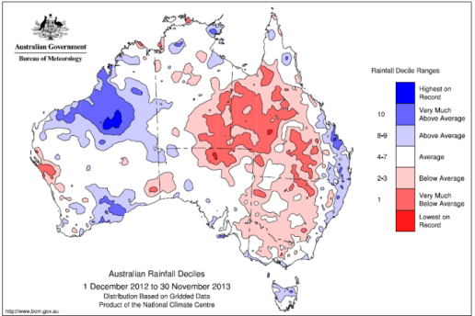
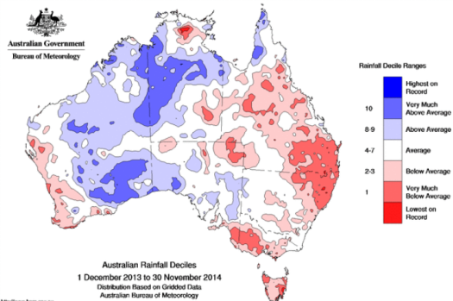
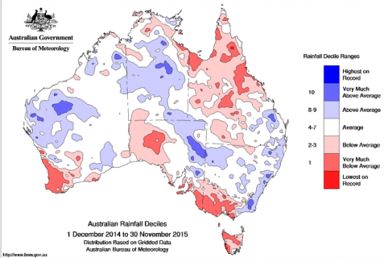
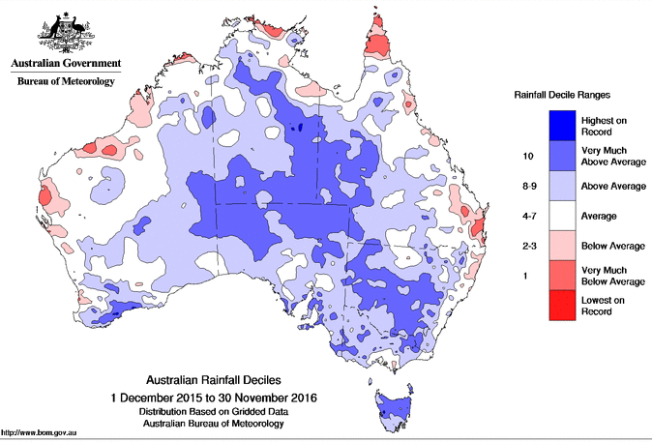
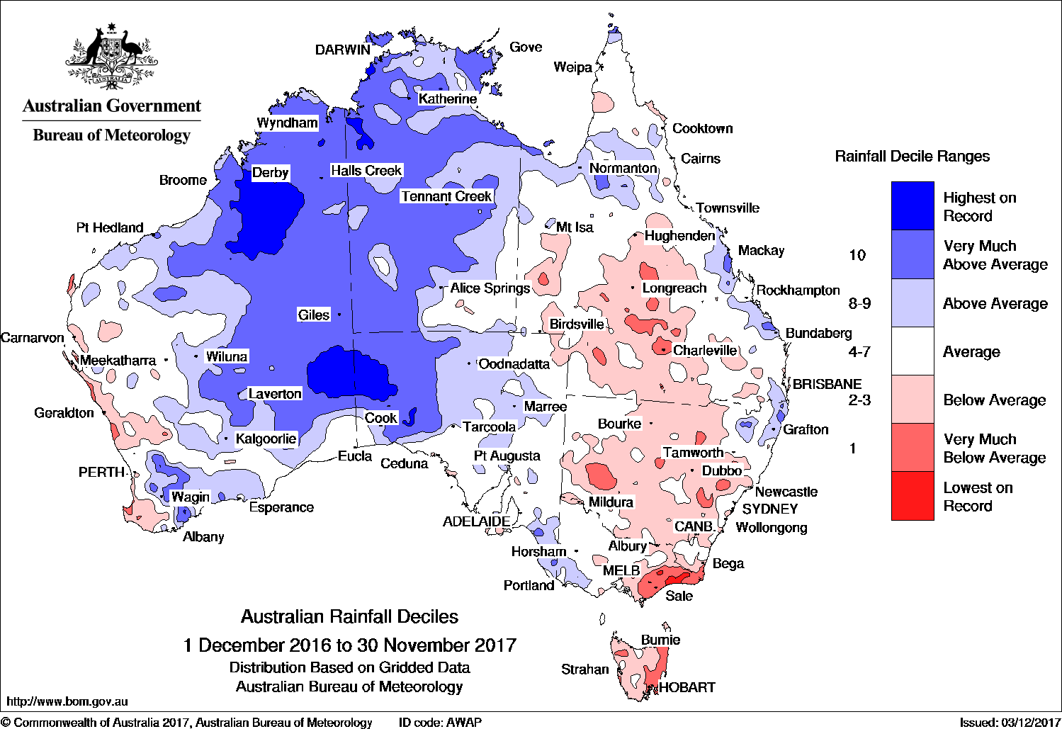
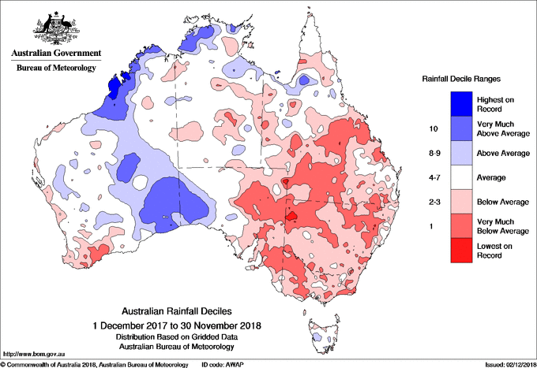
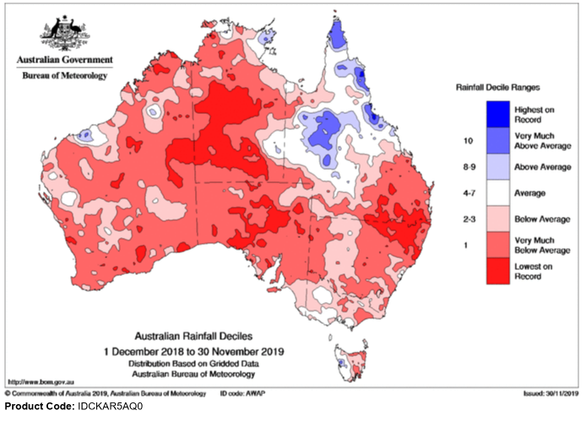
Annual rainfall deciles
2013 to 2019
2013
(Deciles = rainfall received compared to historical averages)
2014
2015
2016
2017
2018
2019
Source: www.bom.gov.au

Slide 6
Year-to-date rainfall 2019
Most of Australia has experienced below to very much below average rainfall in 2019.
For Australia, it was the second driest January - November period on record and amongst the three driest for NSW, SA, WA and the NT. Victoria has also experienced below to very much below average rainfall for most of the state.
From January to October 2019, 55.8% of Australia was classified as being in serious or severe rainfall deficiency. 88.3% of Australia has had rainfall totals below the median.
Areas of SA, NT, NSW and QLD have experienced the lowest rainfall on record.
Almost all of NSW is drought affected (42%) or in drought (57.7%) (DPI 2019).
More than 66% of QLD is drought affected or in drought (QLD DAF 2019).
About half of QLD (from summer monsoon & ex-tropical cyclone Trevor) and small areas of WA, NT and Victoria have experienced average or above average or greater rainfall in 2019.

Slide 7
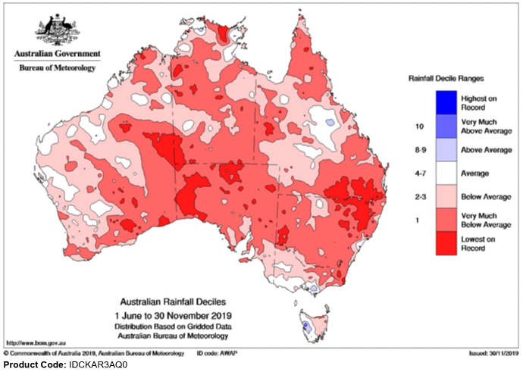
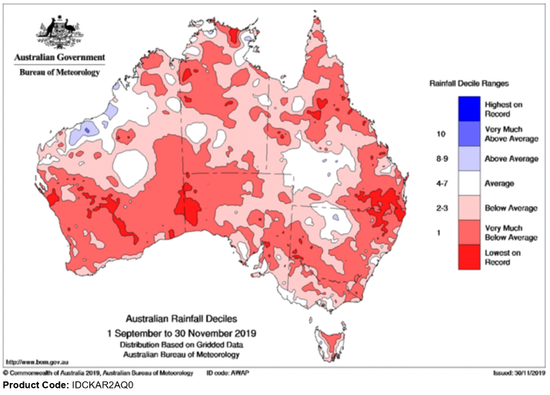
Current rainfall deciles
Winter-spring 2019
Spring 2019
Rainfall for winter - spring was “below” to “very much below” average for almost all of Australia.
During spring, there was some improvement in parts of southern/central QLD and northern NSW, but overall, it was the driest spring on record.
Rainfall for spring was amongst the lowest 10% of historical records for much of NSW, eastern QLD, nearly all of southern half of WA, large parts of the NT, large parts of SA and parts of Victoria and northern Tasmania
Source: www.bom.gov.au

Slide 8
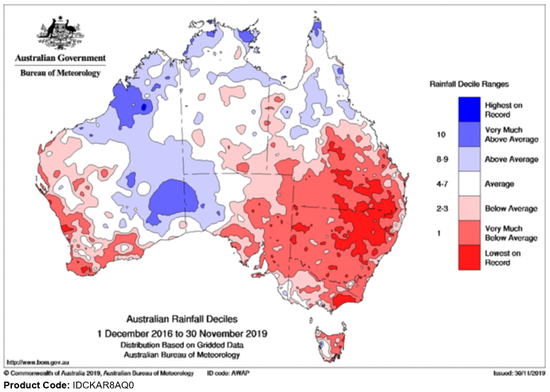
Three-year rainfall
The past three years have seen dry conditions over eastern Australia.
Rainfall for the 34 months from January 2017 to October 2019 has been the lowest on record for the Murray-Darling Basin (MDB) and New South Wales.
Rainfall for the northern Basin was the lowest recorded by a substantial margin, breaking records set in the Federation Drought in 1900-1902.
In Victoria, West Gippsland and East Gippsland each had their driest 34 months on record to October 2019.
Storage volumes in the northern MDB continue to decline, reaching a combined volume in mid-November of 6.7%, which is lower than the lowest point during the Millennium Drought.
Source: Special Climate Statement 70 Update – drought conditions in Australia and impact on water resources in the Murray Darling Basin. BOM 29 Nov 2019

Slide 9
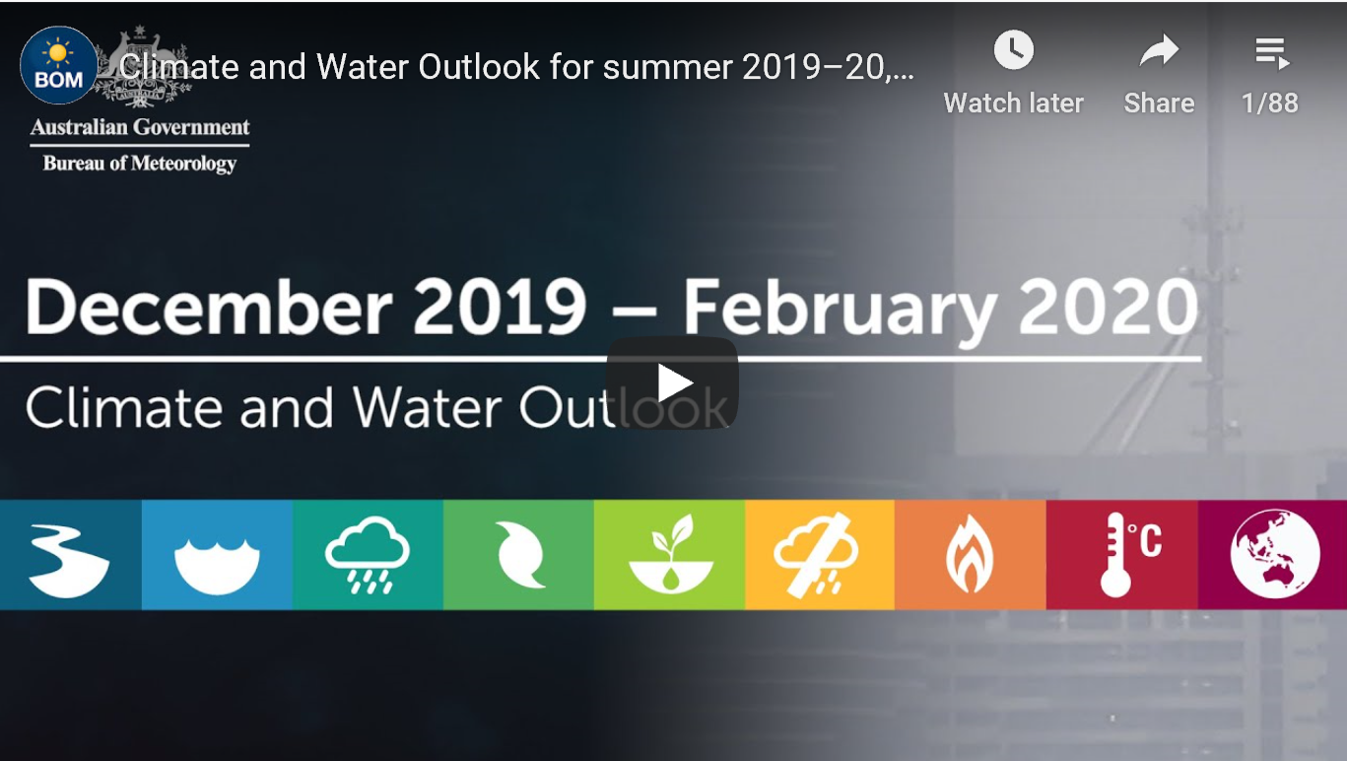
Climate predictions – future conditions

Slide 10
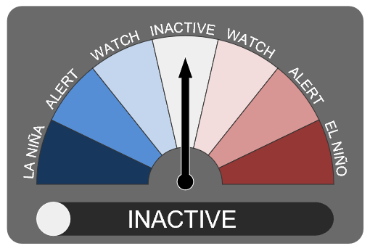
Southern Oscillation Index
The Southern Oscillation Index (SOI) is a proxy used for determining the El Niño Southern Ocean Index (ENSO).
SOI is a key atmospheric index for determining environmental conditions affecting Australia.
SOI can determine two events:
1. La Niña
  Sustained negative values > 8
  Above average rainfall
  Temperatures are below normal
  Flooding tends to occur
2. El Niño
  Sustained positive values < 8
  Drought tends to occur
  Increased heatwaves
  High fire risk
Readings between +7 and -7 are
considered neutral (or stable).
Current conditions
The ENSO outlook is currently INACTIVE. This means there is little sign of El Niño or La Niña developing in the coming months.
The 30-day Southern Oscillation Index (SOI) for November was -10.5 (90-day SOI value -9.7).
Source: www.bom.gov.au

Slide 11
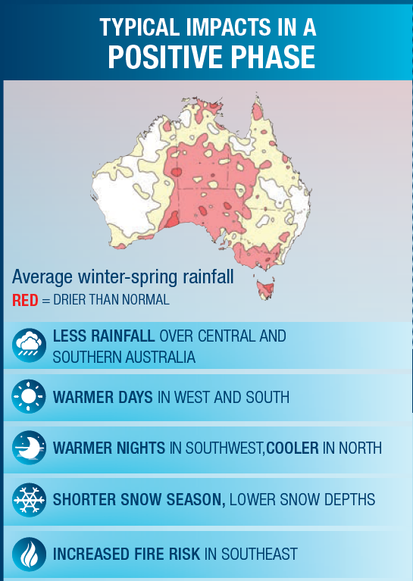
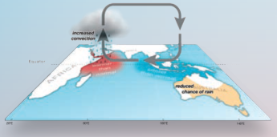
Indian Ocean Dipole
The Indian Ocean Dipole (IOD) is the difference in ocean temperatures between the west and east tropical Indian Ocean, that can shift moisture towards or away from Australia. It is recognised as being one of the key drivers of climate in Australia.
Current situation
Typically, a positive IOD brings below average spring rainfall to southern and central Australia with warmer days for the southern two-thirds of the country.
A strong positive Indian Ocean Dipole (IOD) is currently in place and the main influence on the Australian climate. Significantly warmer than average waters remain near the Horn of Africa, and cooler than average waters persist in the eastern Indian Ocean, south of Indonesia.
International climate models indicate the positive IOD is so strong that it is likely to be slow to decline and could persist into mid-summer.
Source: www.bom.gov.au

Slide 12
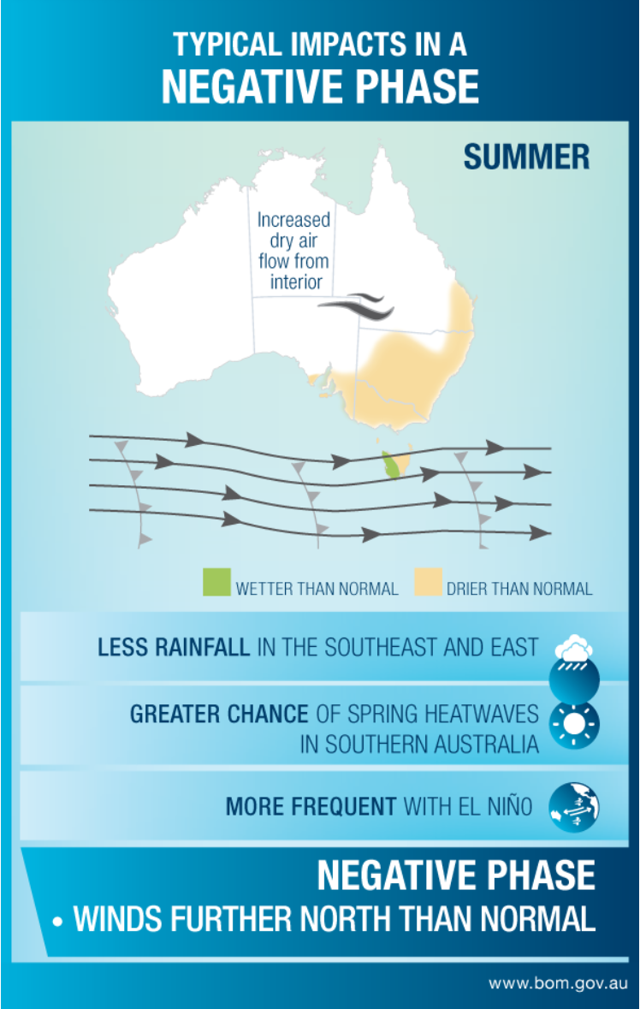
Southern Annual Mode (SAM)
A negative SAM in summer can cause drier than normal conditions over southeast SA, Victoria, most of NSW and the southeast coast of QLD.
In a negative SAM phase, the belt of westerly winds expands towards the equator and Australia. Shifting the westerly winds to the north in summer means less moist onshore flow from the east and typically decreases rainfall over eastern Australia.
Australia is currently experiencing a negative SAM which is likely to remain until late-summer, causing drier than normal conditions.
Source: www.bom.gov.au

Slide 13
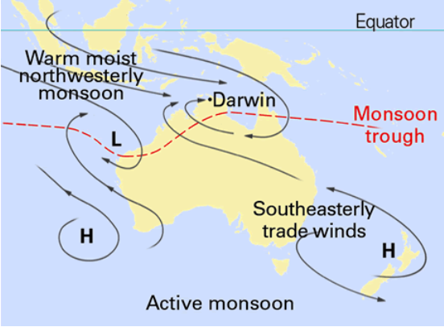
The Australian Monsoon
“Monsoon” describes the seasonal reversal of winds that occurs over parts of the tropics. The monsoon is associated with cloudy conditions, lengthy periods of heavy rain, occasional thunderstorms and fresh to strong squally winds. This often causes flooding in affected areas.
Current situation
The monsoon trough is yet to reach the southern hemisphere after a record late retreat from India. This increases a delay to the start of the wet season for tropical Australia.
The delayed onset of the monsoon will delay any improvement to northern wetlands.
Source: www.bom.gov.au

Slide 14
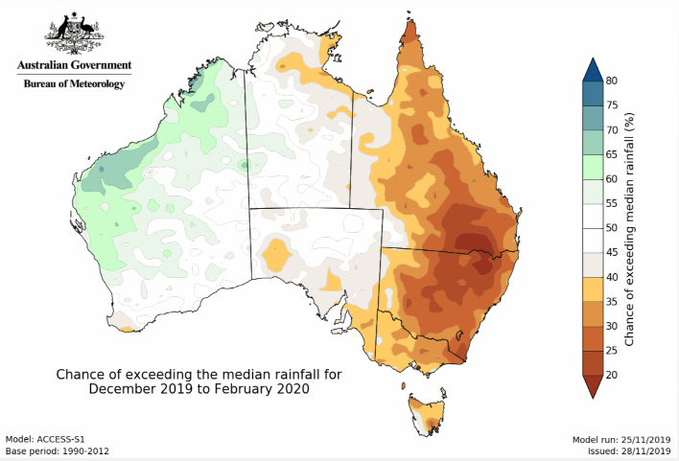
Summer rainfall prediction (Dec -Feb)
The summer rainfall prediction can be used to indicate the potential impact on habitat for the up coming season.
Summer 2019/20 prediction
December to February is likely to be drier than average for most of eastern Australia.
Parts of WA are predicted to receive above average rainfall.
For the rest of Australia (central), there are roughly equal chances of a wetter or drier three months, i.e. no strong tendency towards a wetter or drier than average season ahead.
Next update will be on 20 December 2019
Source: www.bom.gov.au

Slide 15
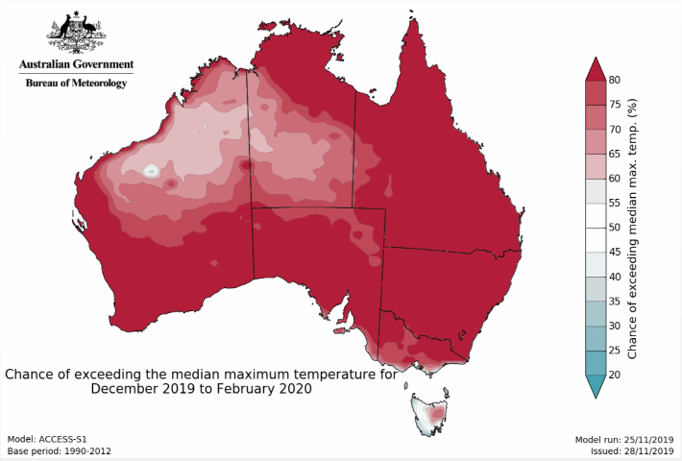
Summer temperature prediction
Summer 2019/20 prediction
Summer (December to February) days are likely to be warmer than average, with probabilities exceeding 80% for approximately two thirds of Australia.
This will result in greater rates of evaporation and the drying of shallow, ephemeral wetlands.
Next update will be on 20 December 2019.
Source: www.bom.gov.au

Slide 16
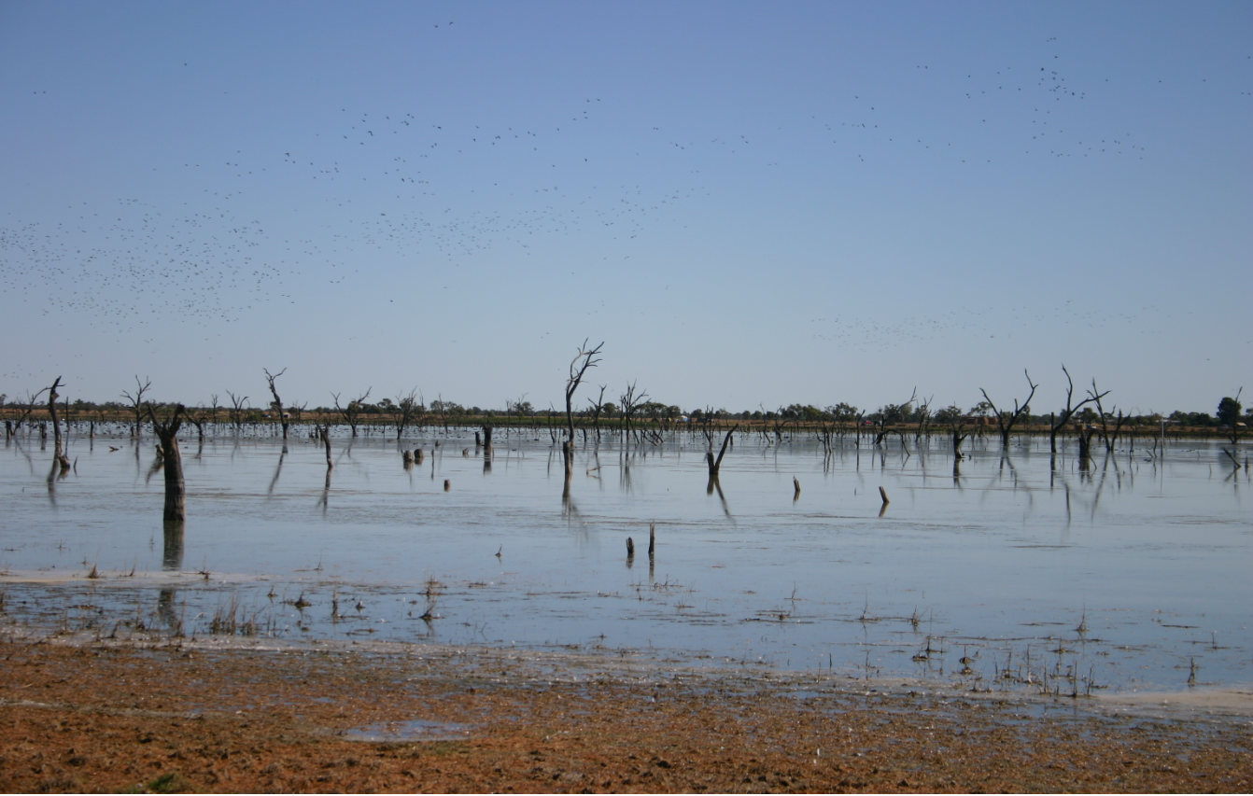
Habitat availability

Slide 17
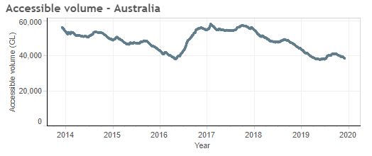
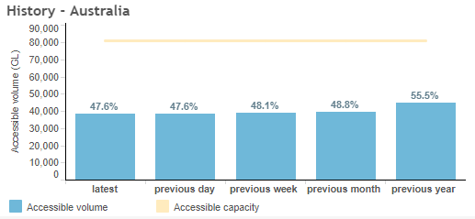
Australian water storage levels
Water storage levels provide an indicator of the availability of waterbird habitat and waterflows through feeder systems.
In 2019, Australia’s water storages declined in volume by 7.9% from the same time last year, from 55.5% to 47.6%.

Slide 18
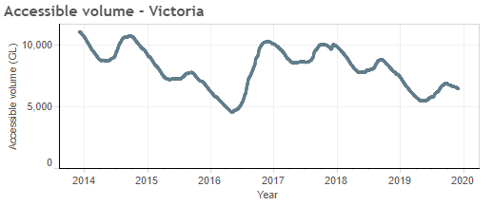
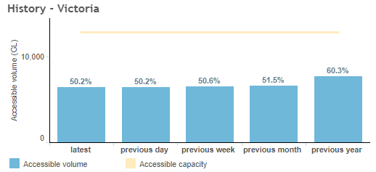
Victorian water storage levels
The total (Melbourne and Regional) Victorian water storage levels are currently at 50.2%.
Storage levels have decreased by 10.1% from the same time last year.
Source: www.bom.gov.au

Slide 19
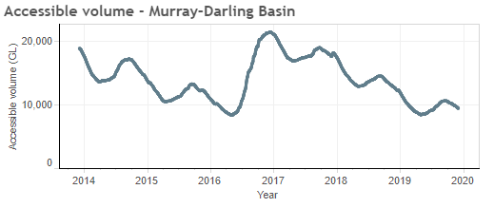
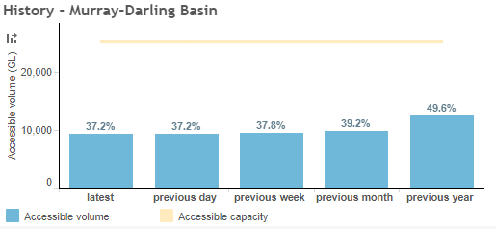
Murray-Darling Basin water storage levels
The Murray–Darling Basin is a critical area for waterfowl production and Australia’s most developed river basin (240 dams storing 29,893 GL).
Storage systems in the MDB are at 37.2 % of capacity, which is 12.4% lower than at the same time last year and 32.7% lower than in 2017.
Storages volumes in the northern MDB continue to decline, reaching a combined volume in mid-November of 6.7% of capacity, which is 1.6% lower than at the lowest point during the Millennium Drought.
Storage volumes in the southern MDB were at 46.7% of capacity at 18 November.
Source: www.bom.gov.au

Slide 20
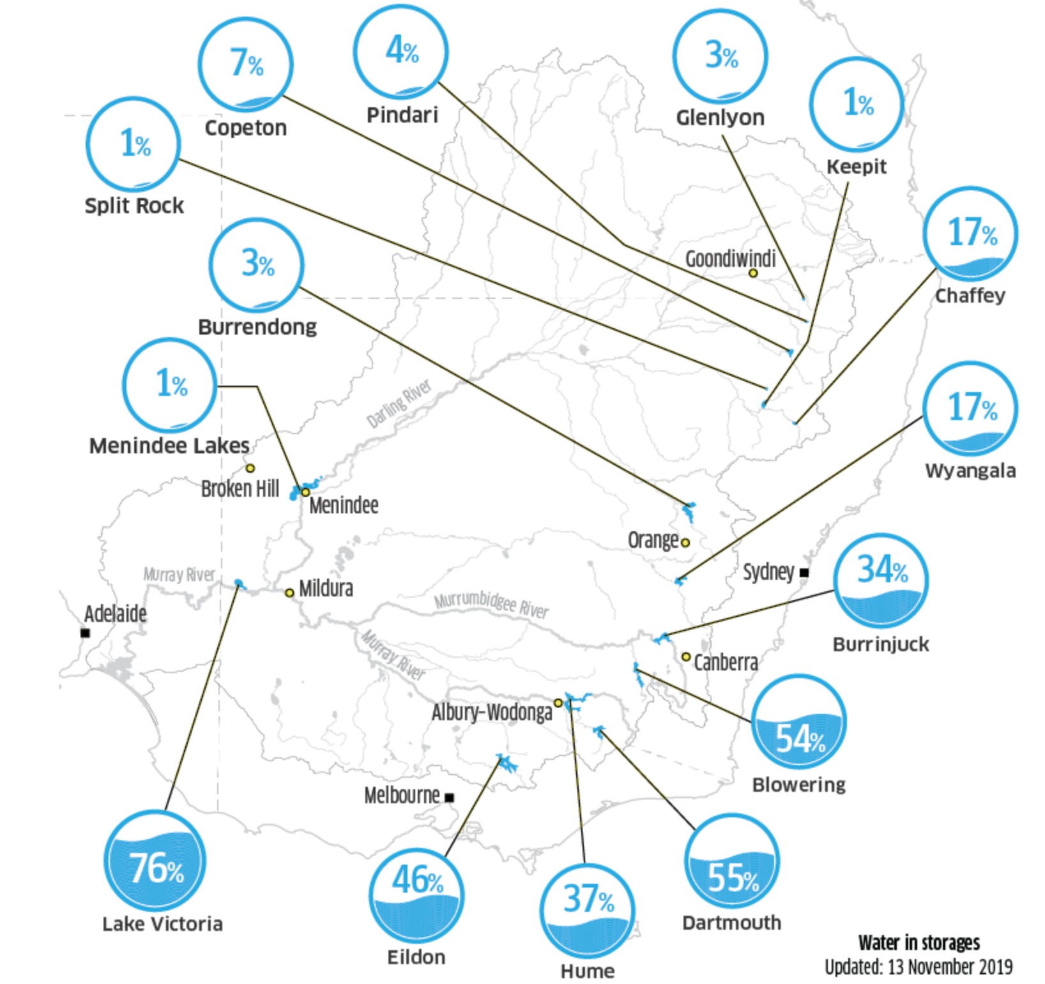
Murray-Darling Basin water storage levels cont.
Water storages in the northern basin continue to deteriorate, with levels continuing to fall. This continues the trend of the past three years, with little indication of improvement for the coming summer.
In the southern Basin, storage levels are less critical, however, predicted hot and dry conditions over summer will put pressure on available water resources.
Source: Murray Darling Basin Authority

Slide 21
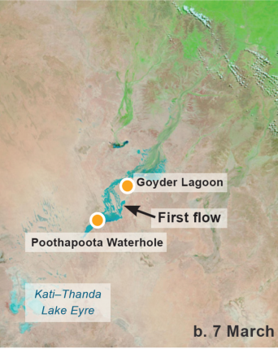
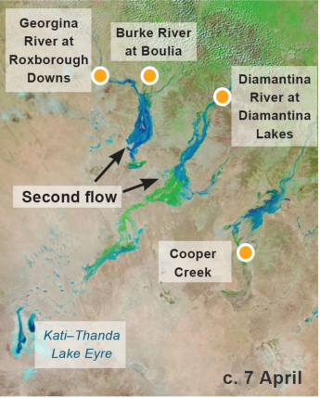
Flows into Lake Eyre
In 2018, annual rainfall was below average across much of the Lake Eyre Basin.
However, two heavy rainfall events across the upper-Diamantina and Georgina River catchments (summer monsoon and ex-tropical cyclone Trevor) from late-January to March 2019 generated flood activity and runoff into the Lake Eyre Basin. Water reached Lake Eyre in mid-March and early June.
Water running through the feeder river systems into Lake Eyre provided waterbird breeding habitat and would have triggered a breeding event. At the time, game duck abundance was below average.

Slide 22
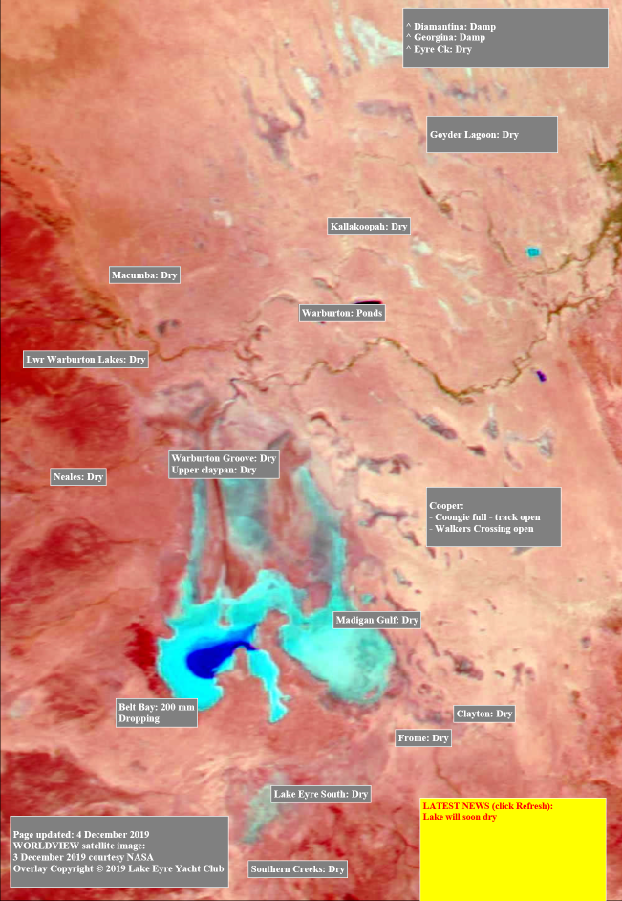
Flows into Lake Eyre cont.
Water levels in Lake Eyre peaked during the first week of July but continued to recede due to evaporation. Feeder systems have largely dried and Lake Eyre is expected to be dry by early-summer.
Despite high rainfall in the north-east of the Lake Eyre Basin earlier this year, the drought continues in the southern Basin. The western Basin is also experiencing severe rainfall deficiencies.
Given it takes approximately 1-2 months for the food systems to respond and 4-5 months for game ducks to pair bond, nest and chicks to fledge, only one breed would have resulted from this flooding event.
Birds using this system would have dispersed to refuge areas. Recently recruited birds are likely to have been detected at wetlands surveyed during the Eastern Australian Waterbird Survey.
Image source: Lake Eyre Yacht Club. Copyright image NASA
Note: only dark blue colour denotes water

Slide 23
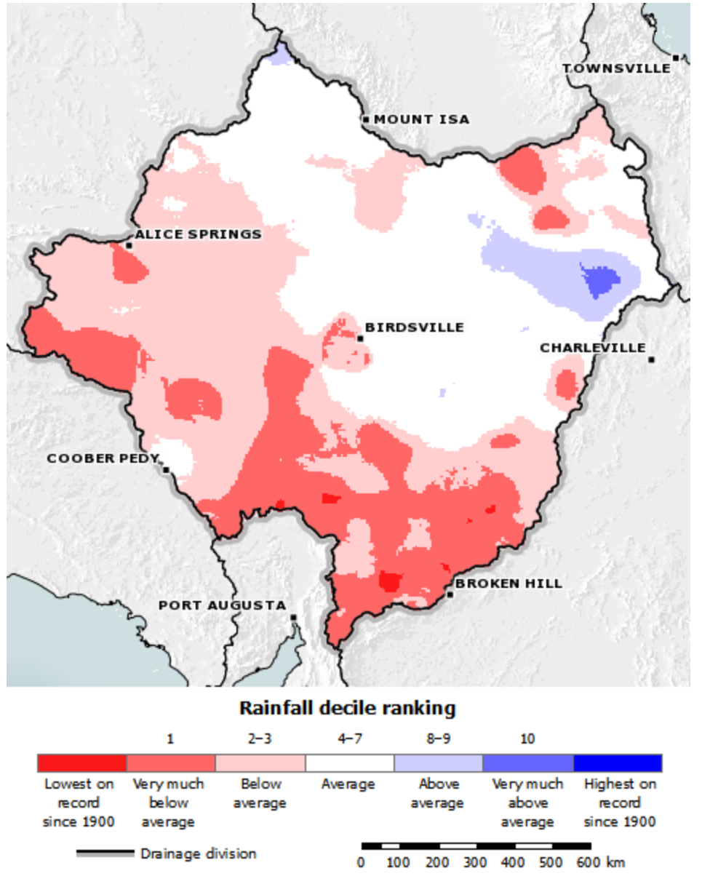
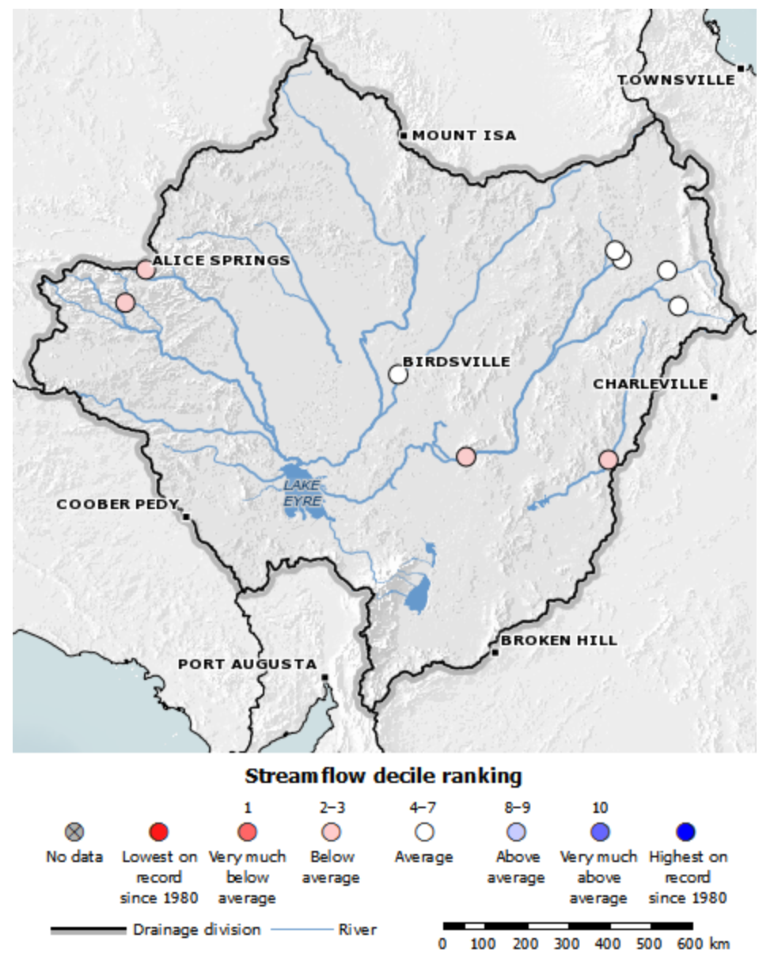
Eyre Basin
Rainfall was average or lower than average for most of the Eyre Basin, particularly in the south.
The far northwest of the Basin received some rainfall at the end of October. Mean rainfall was 5mm, 67% lower than the long-term mean of 15mm.
Streamflows were average or below average for all sites. The only river to flow during October was the Barcoo River at Blackall in the northwest where rain fell during the end of the month.

Slide 24
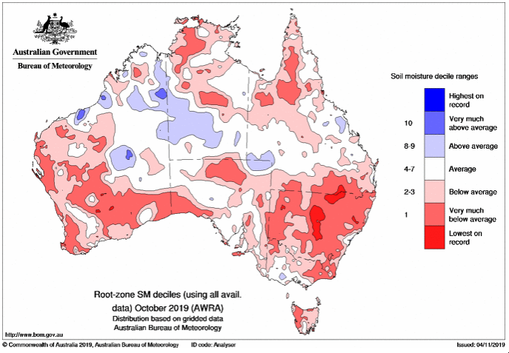
Soil moisture – October
October soil moisture in the root zone (0-100cm) was below average for nearly all of NSW, southern QLD and much of the Peninsula and Gulf Country, much of Victoria away from the south west, central southern and south Gippsland, most of Tasmania, much of northern, south-western and eastern South Australia, most of western and southern Western Australia and pockets of the Kimberly and much of the northern half of the Northern Territory.
Source: www.bom.gov.au

Slide 25
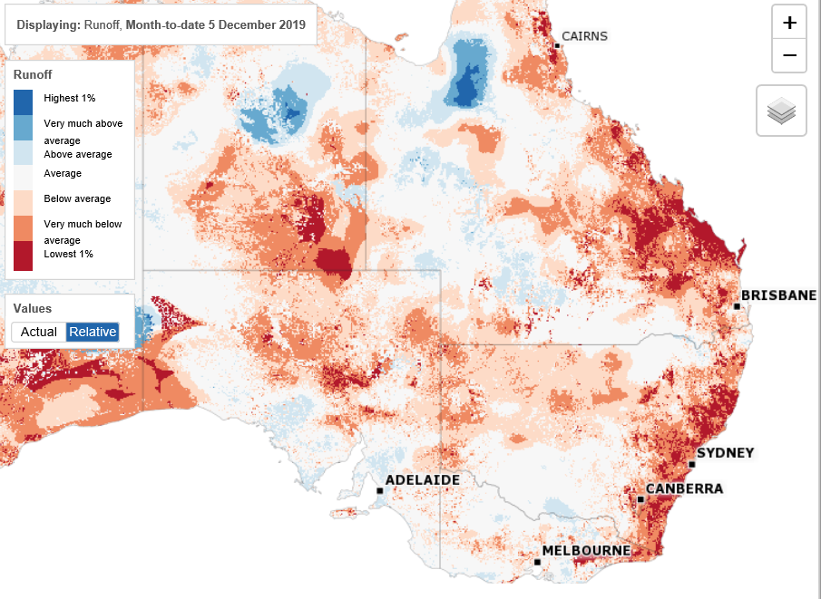
Runoff
Runoff impacts the availability of water in the wetlands and the health of riverine systems. It has a direct influence in the creation and maintenance of waterbird habitat.
Large parts of QLD and NSW have experienced “below average”, “very much below” average to “lowest 1%” runoff during the last month.
Parts of western and northern QLD and southern NSW, northern and southern Victoria and southern SA have experienced “average” to “above average” runoff.
Part of northern QLD has experienced “very much above average” runoff.
Source: www.bom.gov.au

Slide 26
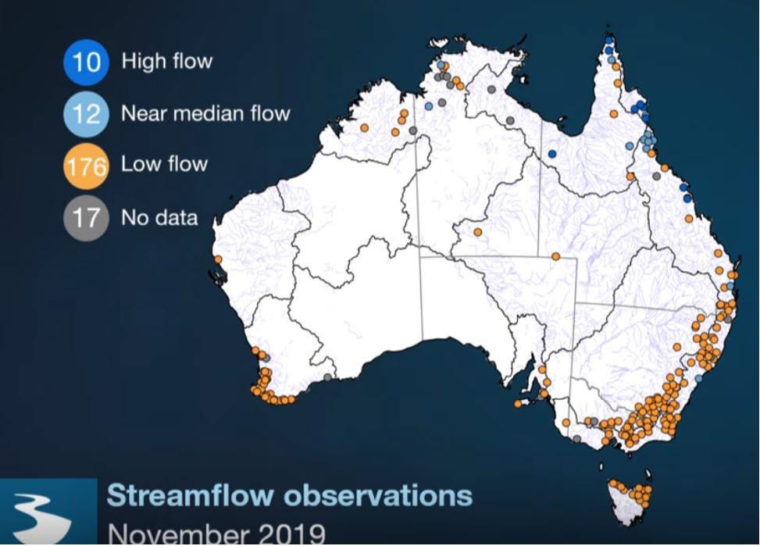
Streamflow predictions
Streamflow has a direct influence on waterbird habitat extent and population abundance. Rivers and creeks provide feeding, resting and breeding habitat and provide inputs into wetlands where they have not been diverted.
Current prediction
For November 2019 – January 2020, low stream-flows are likely at 176 (128 in 2018) locations throughout Australia, near median flows at 12, and high flows at 10.
Victorian predictions indicate lower than median stream-flows are likely in most survey areas.
Note: Forecasts have not been issued for 55 locations due to very low model skill or missing observed data
Source: www.bom.gov.au

Slide 27
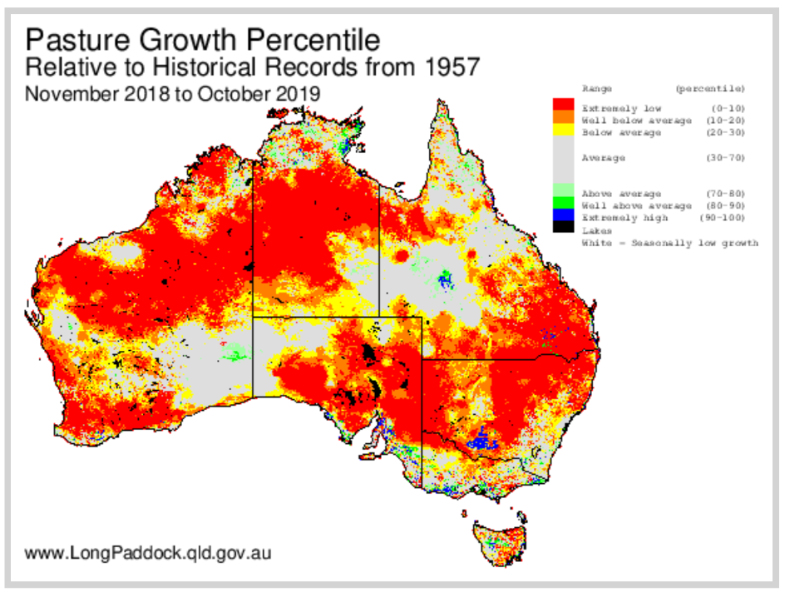
Pasture conditions
Pasture conditions are a coarse indicator of potential feeding habitat for grazing species, such as Wood Duck and Mountain Duck, and nesting habitat for ground-nesting game ducks.
Current conditions
Compared with historical records, large parts of eastern Australia have recorded “well below average” to “extremely low” pasture growth, except for areas in central and northern Queensland and scattered parts of the south-eastern NSW and Victoria which were average.
Some parts of far east and western Gippsland, the south west coast of Victoria and the south east of South Australia have recorded “above average” to “extremely high” pasture growth over the last 12 months.
An isolated area in central Queensland also recorded “above average” to “extremely high” pasture growth over the last 12 months.
Source: www.longpaddock.qld.gov.au

Slide 28
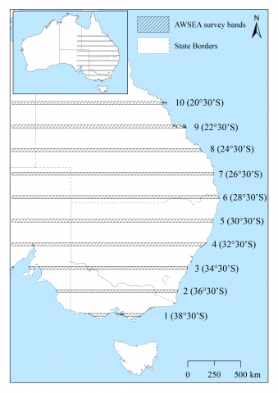

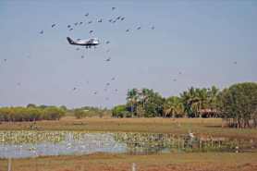
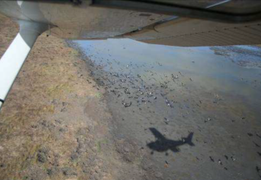
Eastern Australian Waterbird
Survey (EAWS)
The EAWS monitors changes in the abundance and distribution indices of 50 waterbird species in eastern Australia.
The EAWS was designed by Graeme Caughley and has been conducted annually in October since 1983. Waterbirds are counted from the air across ten aerial survey bands (each 30 km in width), every two degrees of latitude, crossing eastern Australia to monitor all wetlands over 1ha in size.
The EAWS provides:
  an index (not total count) of abundance of waterbirds, including game ducks
  information on the distribution of waterbird and game duck populations along survey bands
  the extent and distribution of habitat along survey bands, and
  limited information on waterbird breeding.
The information is valuable for examining waterbird trends on over one-third of continental Australia and over a long period.

Slide 29
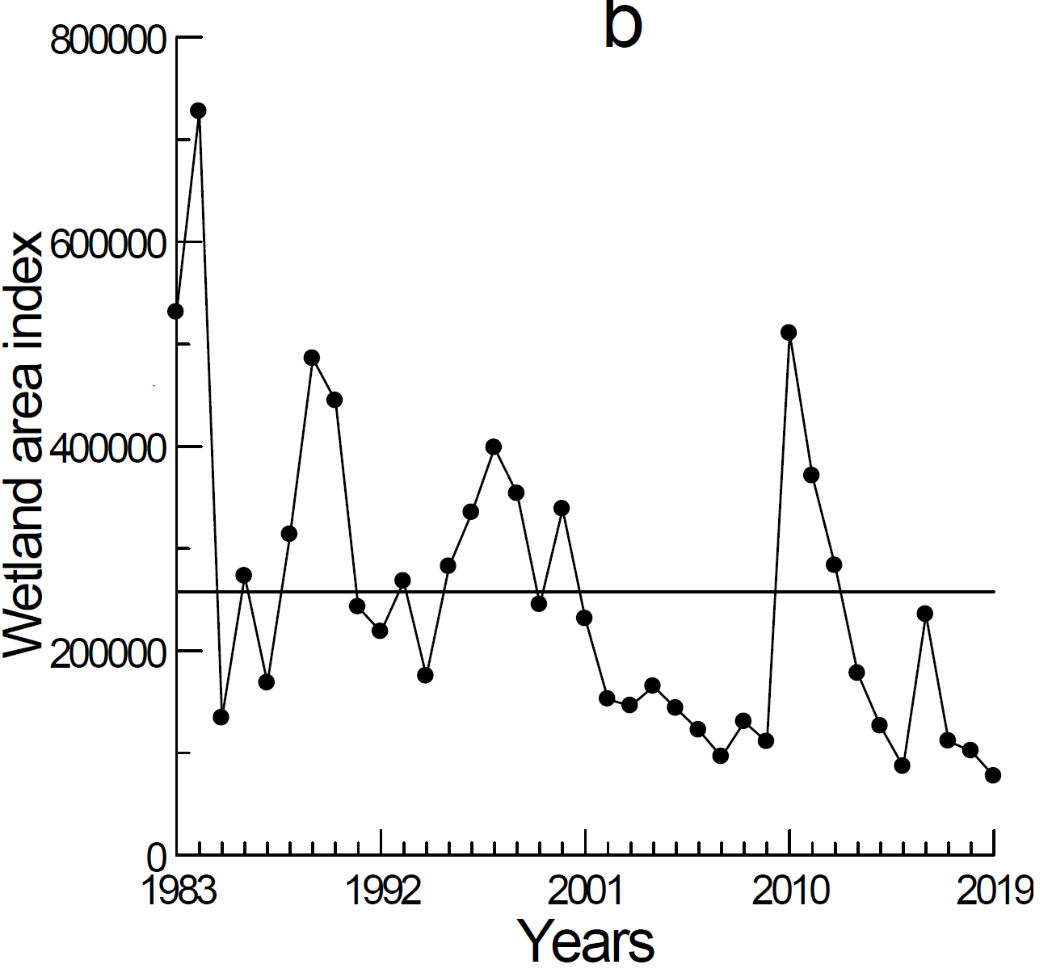
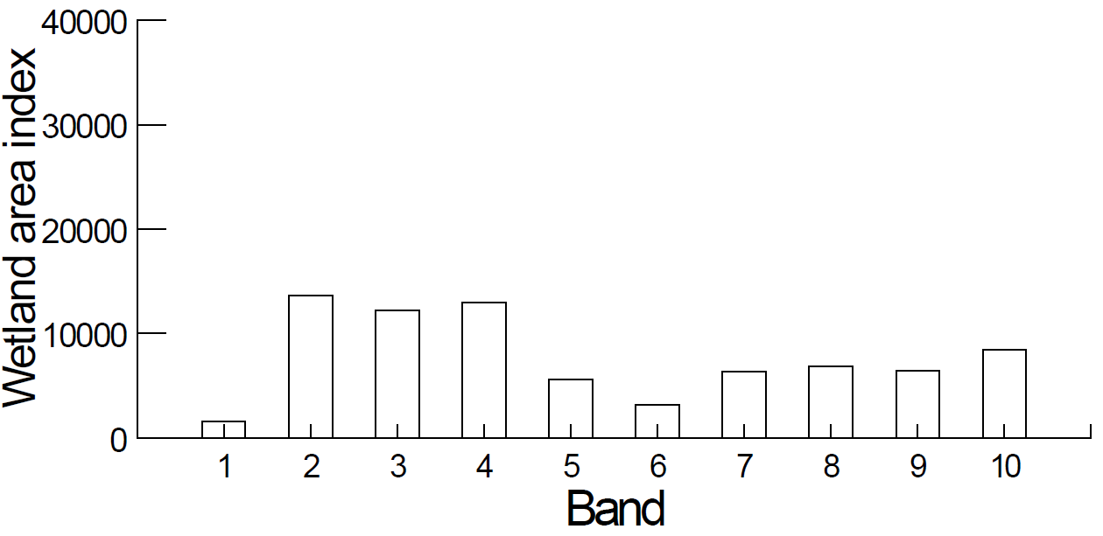
Wetland area index
The wetland area index is a measure of wetland availability across all 10 EAAWS transects. This gives an indication of the habitat available for waterbirds.
The 2019 wetland area index was the lowest recorded since surveys began 37 years ago and reflects the dry conditions across eastern Australia over the last three years.
Long-term wetland area index
Distribution of wetland area across the survey bands
Changes over time in wetland area in the Eastern Australian Waterbird Survey (1983 - 2010); horizontal line shows long-term average.
Wetland area index in relation to the 10 survey bands of the Eastern Australian Waterbird Survey (1983 - 2019); horizontal line shows long-term average.

Slide 30
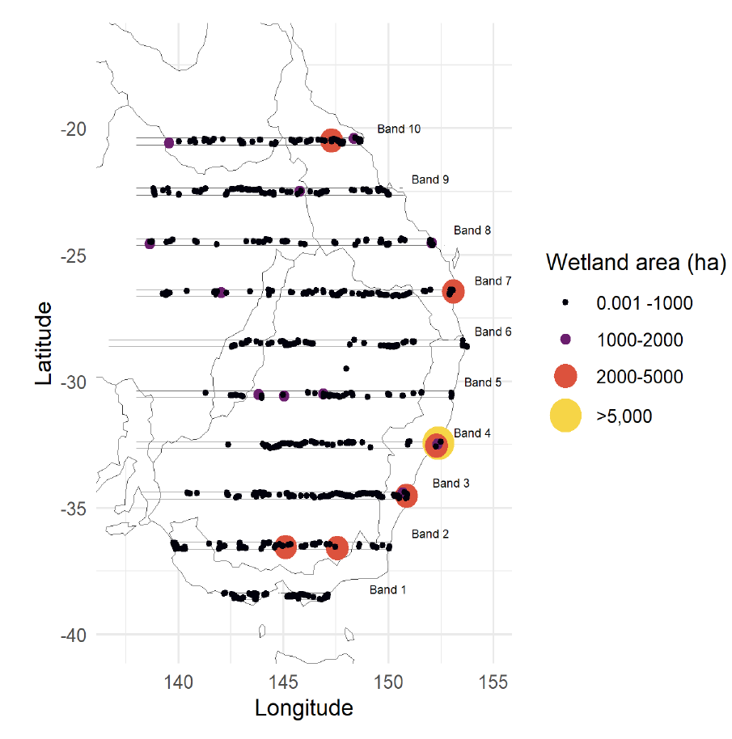
Wetland distribution
2018
2019
All surveyed wetlands with surface water present are plotted; dry wetlands not plotted
The Murray-Darling Basin has experienced its worst drought period in over 120 years and many critical wetland systems in the Basin are dry.
The majority of the habitat surveyed occurred in Bands 2 and 10 and at coastal locations in Bands 3 and 4. Areas in south-west Victoria and south-east South Australia are also holding water.
Some rivers and wetlands in the northern Lake Eyre Basin including the Diamantina and Georgina rivers held small amounts of water and supported low numbers of waterbirds. Lakes Torquinnie and Mumbleberry held water and supported moderate to high numbers of waterbirds. Lake Galilee was shallow and drying and supported the largest concentration with more than 43,000 waterbirds.

Slide 31
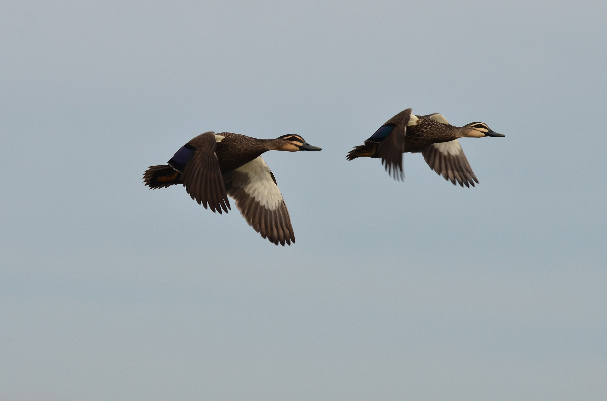
Population indices of abundance and distribution

Slide 32
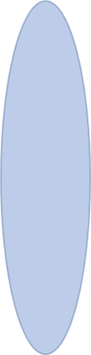
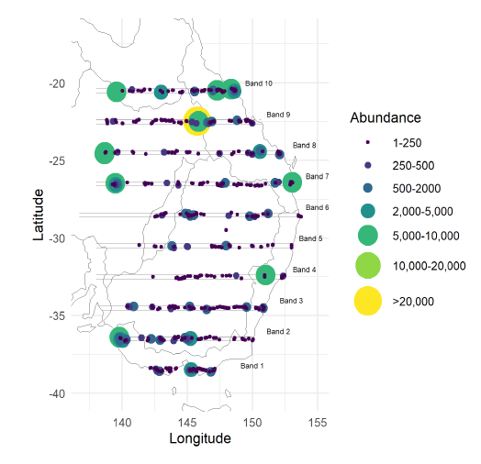
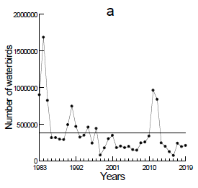
Index of waterbird abundance
(all waterbirds)
Up to fifty waterbirds species are surveyed in October each year and includes all Victorian game duck species and non-game species such as swans, Freckled Duck, ibis, coots etc.
The total index of waterbird abundance (n=208,364) increased by 8% from 2018 (192,906).
The waterbird abundance index is the 13th lowest in 37 years.
Waterbirds were most abundant in Bands 2, 9 and 10.
Dry wetlands and wetlands without waterbirds weren't plotted
The abundance index is not a total count. It provides information on the trends in waterbird abundance along the survey bands.

Slide 33
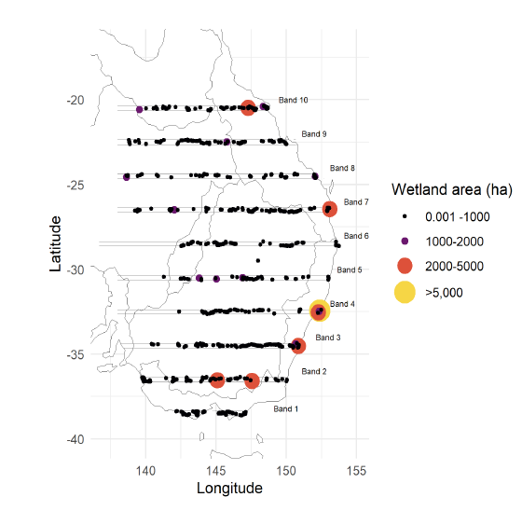
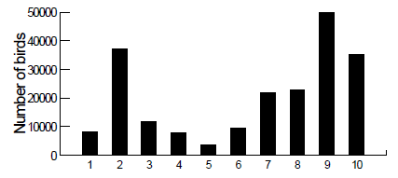
EAWS waterbird distribution
Where are the most birds in relation to wetlands?
Waterbirds were most abundant in Bands 2, 9 and 10.
Surveyed waterbirds were most abundant in Bands 2, 9 and 10.
The majority of the habitat occurred in Bands 2 and 10 and coastal areas on Bands 3 and 4.
Waterbirds were more concentrated and less widely dispersed than last year, reflecting the decline in habitat availability in the Murray-Darling Basin.
Eleven wetlands supported more than 5,000 waterbirds representing 50% of the total abundance.

Slide 34

EAWS Waterbird abundance index
Bands 1 & 2
Waterbird abundance (all species) in Bands 1 and 2 has declined by approximately 40% from 2018.
Note the difference in scales between the graphs.
2018
2019

Slide 35

EAWS game duck abundance index
This index includes information on game ducks only.
The abundance index increased by 8% from the previous year but is well below the long-term average.
The 2019 game duck index was the 13th lowest recorded in 37 years.
Bird detectability can increase during dry periods as birds concentrate on remaining open wetlands. This may have contributed to the observed increase, but the extent is unknown.

Slide 36

Game duck abundance index cont.
When considering management implications, the abundance index must be considered in context with:
distribution of birds
habitat availability and distribution
climatic forecasts
concentrations of birds
This graph includes abundance index data (red line) and the rolling (or moving) average (green line). A rolling average is a technique used to get an overall trend in a data set. In this case, the rolling average is calculated for three-year subsets.
The long-term average and median abundance levels are also included. The median is the mid-value and is more statistically suitable than the average when outliers are present.

Slide 37

Relative abundance of game duck species 1983-2018 (EAWS)
The majority of game ducks detected in 2019 EAWS were:
Black Duck 36.1% (8.5), Grey Teal 27.6% (56.8), Wood Duck 25% (6.7), Pink-eared Duck 2.1% (5.8) and Hardhead 0.3% (17.0).
Figure in parentheses are from 2018.

Slide 38

Waterbird breeding (all species combined)
The EAWS total breeding index (all species combined) increased from the previous year but remains well below the long-term average.
EAWS breeding species richness (i.e. the number of different species observed breeding) was also low, with only six species recorded breeding: Black Swans and Straw-necked Ibis comprised 97% of the total.
With the exception of 2016, breeding has been supressed following the
major wet period in 2010-12.

Slide 39



Waterbird breeding (all species combined)
Most of the breeding occurred in Band 1, with some occurring in band 9. Only six species were recorded breeding.
Breeding was heavily concentrated at one site – Rhyll Swamp, Westernport Bay, in Band 1.
Only wetlands with breeding recorded are plotted.

Slide 40


Game duck breeding
The 2019 opening weekend bag survey showed varying levels of breeding from the previous year (2018) for all game species, ranging from 14.6% - 44%. In total, first year birds comprised 27% of the total harvest.
For 2019, a new and more robust process to collect this data was introduced. Ageing was done according to a more rigorous process and regions were introduced to reflect regional variation. There is no reliable recent data to compare this figure to.
Birds will breed locally where conditions are good. However, the main production areas within the Murry-Darling Basin were largely dry and breeding was reduced.
Flooding in the Eyre Basin earlier this year allowed ducks to breed once, contributing new recruits to the population. This system has largely dried following flooding earlier this year.

Slide 41


Interactions: abundance, breeding and habitat
Overall waterbird abundance, breeding index and breeding species increase with available habitat (wetland area index).
Declines in wetland area are likely to result in declines in waterbird abundance, breeding and the number of species breeding (species breeding richness).

Slide 42

EAWS wetland area and waterbird abundance trends over time
All major indices for waterbirds (total abundance, breeding index, number of species breeding and wetland area index) continue to show significant declines over time.
Long-term trends are more informative for predicting population status than year-to-year fluctuations.

Slide 43

Game duck abundance, distribution and habitat - summary
Where the ducks are
Where the habitat is
Where the habitat is

Slide 44

Victorian harvest estimates 2019

Slide 45
2019 harvest estimates
Harvest statistics can provide information on the health and dynamics of game duck populations, including distribution, abundance and productivity.
Due to continued dry conditions and low game duck abundance, the 2019 duck season was modified. There was a maximum of 24,925 Game Licence holders endorsed to hunt duck in 2019.
Over the opening weekend, 42% of licence holders (10,493) hunted, 19% of the total seasonal harvest (45,676 ducks) was taken and an estimated 4.4 ducks were harvested per licence holder. For the whole of the season, 81,023 hunter days were recorded and each licence holder hunted an average of 3.3 days.
The total seasonal harvest was estimated at 238,666 ducks and each licence holder took an average of 2.94 ducks per hunting day. An estimated 9.6 ducks were harvested per licence holder for the season. 55% (13,550) hunters were active throughout the season.
47% of hunting occurred on public land only and 46% on private land only. 6% of hunting occurred on both public and private land. 48% of ducks were harvested solely on private land and 44% on public land, with the remainder occurring on both.
Total harvest was estimated to be greatest in the West Gippsland CMA, followed by Corangamite and North Central CMA.
The following table summarises this information
Source: Moloney, P.D. and Powell, Z. (2019) Estimate of duck and Stubble Quail harvest in Victoria for 2019.

Slide 46
Modified season arrangements
1. Two (2) birds per day with an additional three (3) Wood Duck. No Blue-winged Shoveler, Pink-eared Duck or Hardhead duck (49 day season)
2. Five (5) birds per day with an additional three (3) Wood Duck. No more than 1 Blue-winged Shoveler (72 day season)
3. Ten (10) birds per day which included a maximum of two Blue-winged Shoveler on opening day. Five (5) birds per day which includes a maximum of one Blue-winged Shoveler for remainder of season (80 day season)
4. Eight (8) birds on opening day. Four (4) birds per day for remainder of the season. No Blue-winged Shoveler hunted in 2016 (87 day season)
5. Ten (10) birds per day. No Blue-winged Shoveler hunted in 2017 (87 day season)
6. Ten (10) birds per day. No Blue-winged Shoveler hunted in 2018 (87 day season)
7. Four (4) birds per day on opening weekend. Five (5) birds per day for the remainder of the season. No Blue-winged Shoveler hunted in 2019 (65 day season).
Long-term harvest estimates
Estimates | 2009¹ | 2010² | 2011 | 2012 | 2013 | 2014 | 2015³ | 2016⁴ | 2017⁵ | 2018⁶ | 2019⁷ | Average 2009-19
Licensed hunters | 18,348 | 21,861 | 23,716 | 24,533 | 24,036 | 26,261 | 25,837 | 25,681 | 26,324 | 25,799 | 24,925 | 24,301
Total # hunter days | 76,659 | 85,801 | 103,450 | 109,718 | 91,748 | 118,800 | 91,264 | 100,749 | 96,508 | 91,570 | 81,023 | 95,151
Total harvest | 222,302 | 270,574 | 600,739 | 508,256 | 422,294 | 449,032 | 286,729 | 271,576 | 438,353 | 396,965 | 238,666 | 373,229
Average # days hunted in the season | 4.0 | 4.0 | 4.5 | 4.6 | 3.7 | 4.6 | 3.6 | 3.9 | 3.8 | 3.6 | 3.3 | 3.97
Seasonal harvest per licence holder | 11.1 | 12.5 | 26.0 | 21.2 | 17.2 | 17.3 | 11.4 | 10.5 | 17.4 | 15.7 | 9.62 | 15.46
Opening weekend bag per hunter | 4.5 | 4.2 | 9.2 | 5.3 | 9.5 | 5.7 | 5.8 | 5.1 | 7.1 | 6.3 | 4.4 | 6.1
Average # ducks per day hunted | 2.7 | 3.1 | 5.7 | 4.6 | 4.6 | 3.7 | 3.1 | 2.6 | 4.5 | 6.4 | 2.9 | 3.90
Harvest estimates are at 95% confidence intervals

Slide 47




Estimates of harvest per game duck species
Grey Teal, Wood Duck and Black Duck consistently make up the majority of the harvest each year

Slide 48

Summary

Slide 49

Summary
With the exception of 2016, much of eastern Australia has received below average rainfall since 2013. Almost all of NSW and the majority of QLD is currently drought affected.
A key waterfowl production area, the Murray Darling Basin, is experiencing its worst 2-3 year drought in over 120 years.
The Eyre Basin experienced a significant flood event in early-2019, creating significant short-term habitat. A single breeding event was triggered.
The wetland area index is the lowest recorded in 37 years, reflecting the extremely dry conditions.
Waterbird habitat is largely restricted to central QLD, southern NSW/northern Victoria, south-western Victoria and south-eastern South Australia. There is very little habitat available in the Murray-Darling Basin. Habitat created in the Eyre Basin as a result of flooding in QLD earlier this year has largely dried.

Slide 50
Summary
Game duck abundance increased slightly from last year but is well below average. Birds are confined to north/central QLD, southern NSW/northern Victoria and south-western Victoria and south-eastern South Australia.
Given the absence of habitat in central eastern Australia, there is limited opportunity for large-scale movement between north and south.
Excluding 2016, there has been very little large-scale waterbird breeding since 2013 and the existing populations constitute core breeding stock.
A positive IOD, negative SAM and delay to the onset of the monsoon are contributing to the prediction for a hotter and drier summer for eastern Australia. Should this occur, waterbird habitat availability will continue to decline.
Waterbird abundance, breeding and habitat availability are showing long-term declines.

Slide 51
References
Bureau of Meteorology - www.bom.gov.au
Bureau of Meteorology (2019) Special Climate Statement 70 Update – drought conditions in Australia and impact on water resources in the Murray Darling Basin.
Department of Primary Industries (DPI) 2019: https://edis.dpi.nsw.gov.au/
Jenouvrier S. (2013) Impacts of climate change on avian populations. Glob Change Biol, 19: 2036-2057. doi:10.1111/gcb.12195
Kingsford R. T. and Norman F. I. (2002) Australian waterbirds—products of the continent's ecology, Emu - Austral Ornithology, 102:1, 47 69, DOI: 10.1071/MU01030
Moloney, P.D. and Powell, Z. (2019) Estimate of duck and Stubble Quail harvest in Victoria for 2019: results from surveys of Victorian Game Licence holders in 2019. Unpublished Client Report for the Game Management Authority. Arthur Rylah Institute for Environmental Research, Department of Environment, Land, Water and Planning, Heidelberg, Victoria.
Murray Darling Basin Authority – www.mdba.gov.au
Porter JL. Kingsford RT. Brandis K (2019) Aerial Survey of Wetland Birds in Eastern Australia- October 2019 Annual Summary Report, University of New South Wales 2018.
Queensland Government 2019. Drought declarations (Department of Agriculture and Fisheries): http://www.longpaddock.qld.gov.au/drought/drought-declarations/
The Long Paddock- www.longpaddock.qld.gov.au

